Slide 1


Similarity Analysis: For T2DM Using Moment of Inertia Tensor
IDS PROJECT PRESENTATION
Course Instructor :
Dr Gaurav Bhatnagar
Shisheer S Kaushik
M23IQT006
01

Slide 2
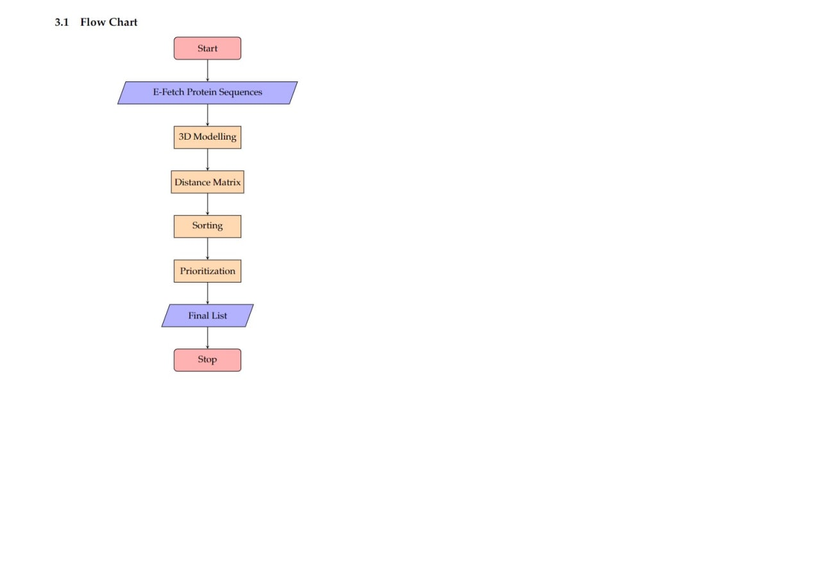
Overview
We consider the protein sequence as a rigid-body of discrete mass distribution and transformed into vectors by the tensor for moment of inertia.
From the calculated Eigen Values, The Euclidean distance is employed as a measurement of the similarities.
The closeness between the Genes is inferred from the constructed phylogenetic tree.

Slide 3
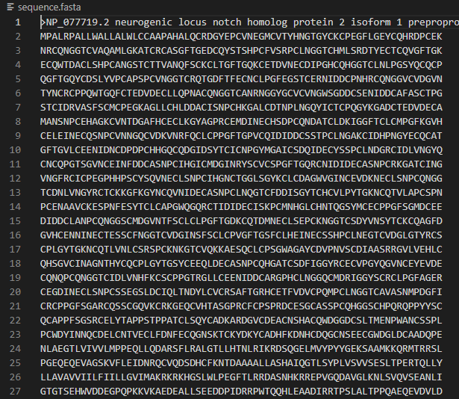
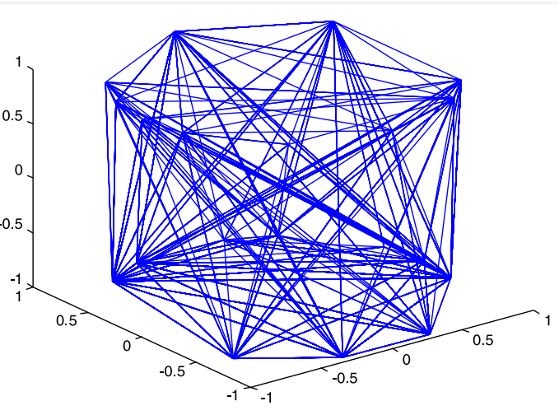
FROM FASTA FILE:
TO 3D MASS DISTRIBUTION

Slide 4
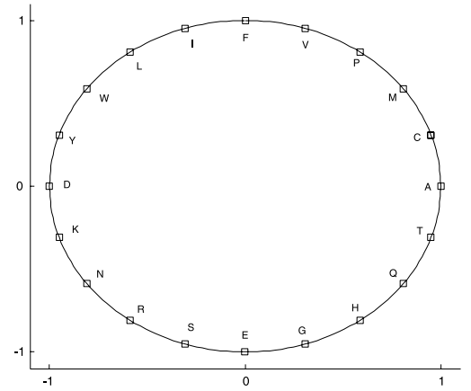
FOR X AND Y COORDINATE
Two main physiochemical parameters-:
1.Hydrophobicity
weak hydrophobic amino acids {M, V, A, P, C} Q1
strong hydrophobic amino acids SH {F, L, I, Y, W}; Q2
weak hydrophilic amino acids WP {T, H, Q, E, G}; Q3
strong hydrophilic amino acids SP {S, N, K, D, R}; Q4
xi = cos(2π i/20), yi = sin(2π i/20), i = 0, 1, 2 . . . 19.
Source: 2

Slide 5
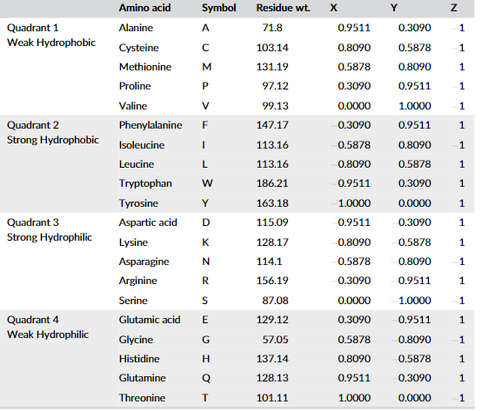
GRAPHICAL REPRESENTATION
Relative Residue Weight
G < A < S < P < V < T < C < I = L < N < D < Q < K < E < M < H < F < R < Y < W
The z-axis coordinates of ten amino acids, which have smaller molecular mass, are labeled by −1. Other amino acids are labeled by 1 in z-axis.

Slide 6
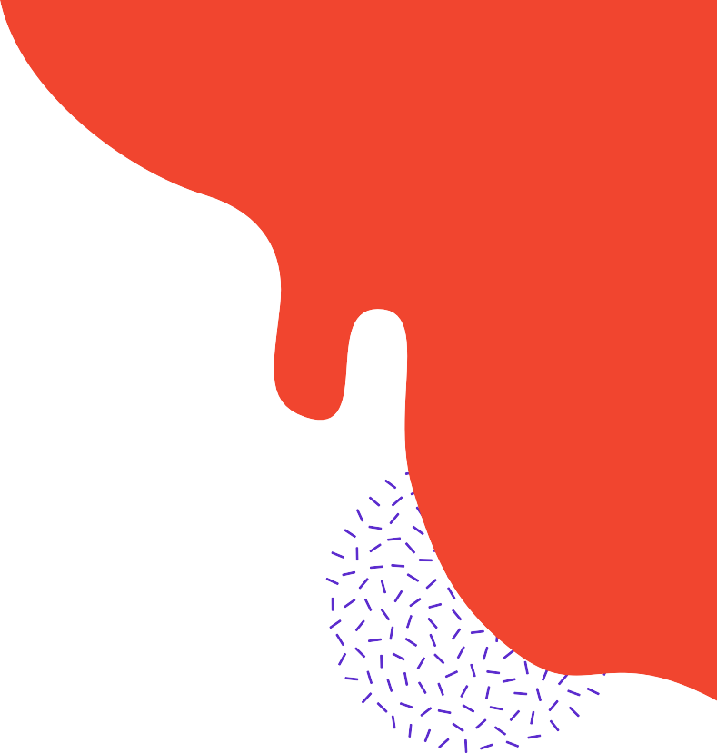
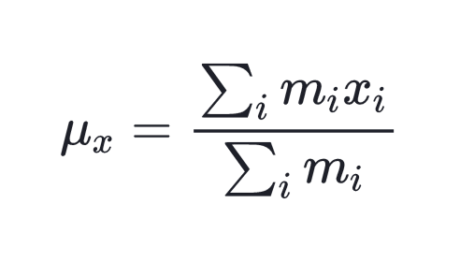
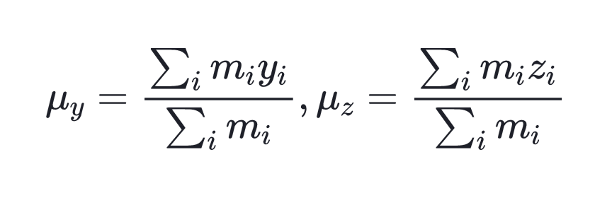
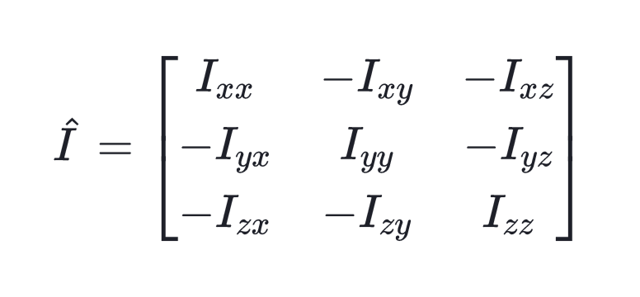
MOMENT OF INERTIA OF A 3D-MODEL
Using the coordinates of each amino acid 3D models for all the genes are made by applying the moment of inertia tensor concept considering the mass m=1 for amino acid.
The coordinates of the center of mass of the 3-D graph-
where x_i, y_i, z_i are the coordinates of material point m_i.
The tensor of the moments of inertia is defined by the matrix-:
06

Slide 7
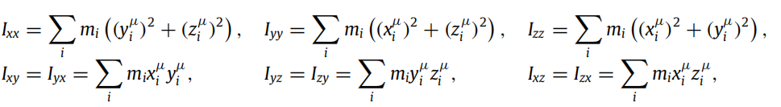

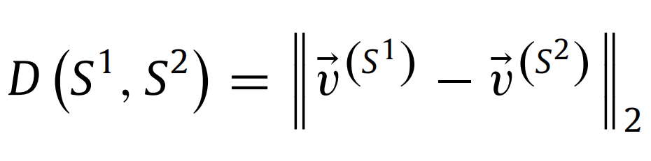
The elements of the matrix are defined as-:
where xµi , yµi , zµi are the coordinates of mi in the Cartesian coordinate system for which the origin has been selected at the center of mass
By calculating the eigenvalues of matrix I, labeled by λ1, λ2 and λ3, v(S) = (λ1, λ2, λ3), a vector is constructed to represent the protein sequence S, and obtain the similarity of two sequence S1, S2 from the Euclidean distance
03
Two sequences would be relatively similar if the value D is extremely small

Slide 8
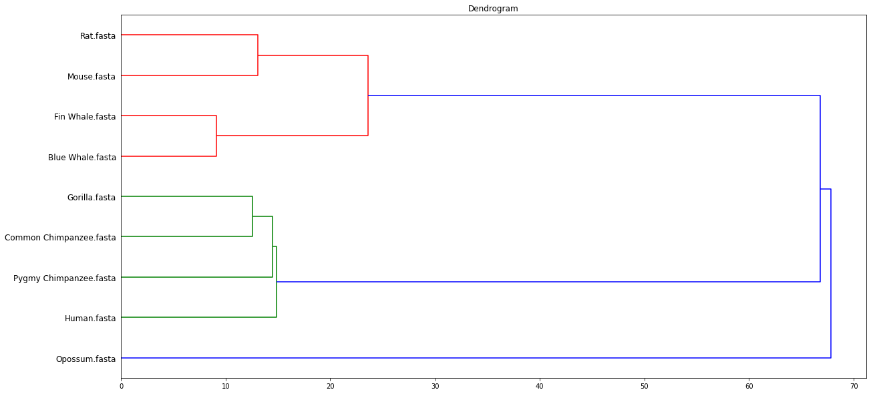
Overview of phylogenetic tree
Pairs(blue whale, fin whale),(common chimpanzee, gorilla), (human, common chimpanzee), (pigmy chimpanzee, common chimpanzee) and (pigmy,chimpanzee, gorilla) have the shorter distance according to our models.
Human, common chimpanzee, pigmy chimpanzee and gorilla are in the same branch of the tree. These results agree with the classical evolution theory.

Slide 9
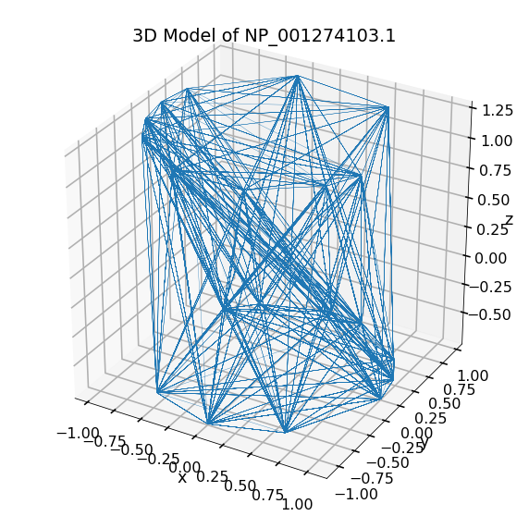
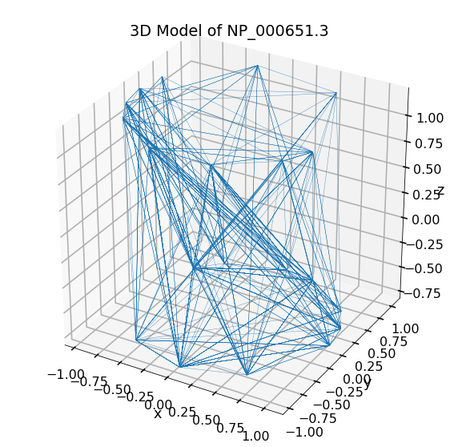
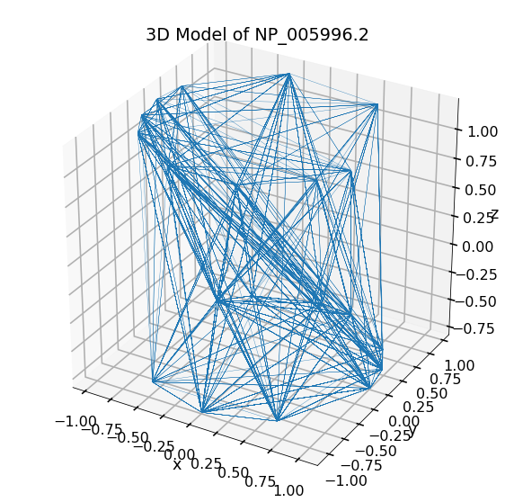
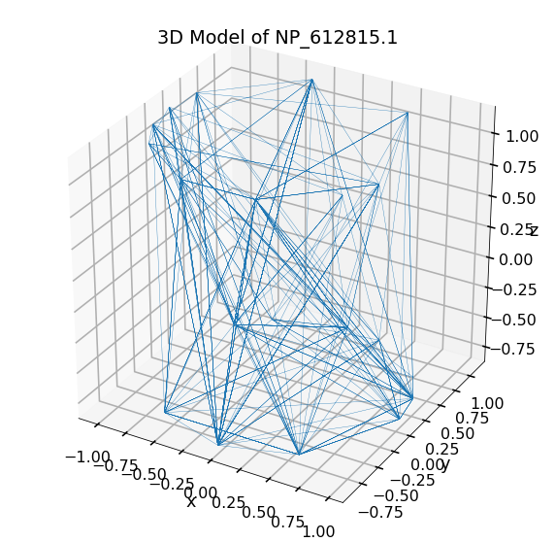
SIMILARITY ANALYSIS BETWEEN DISCRETE MASS DISTRIBUTION

Slide 10
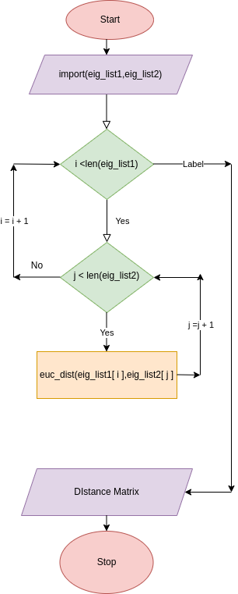
DATABASE

Slide 11
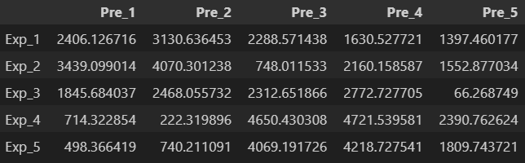
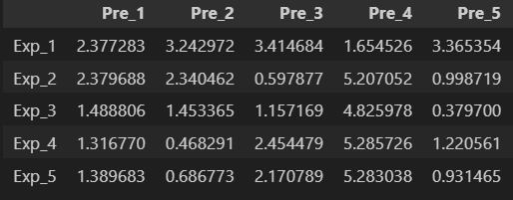
DISTANCE MATRIX COMPARISON
Euclidean Distance
Mahalanobis Distance

Slide 12
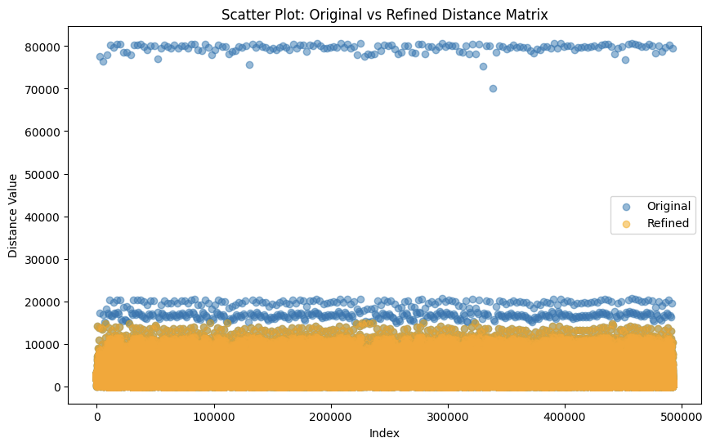
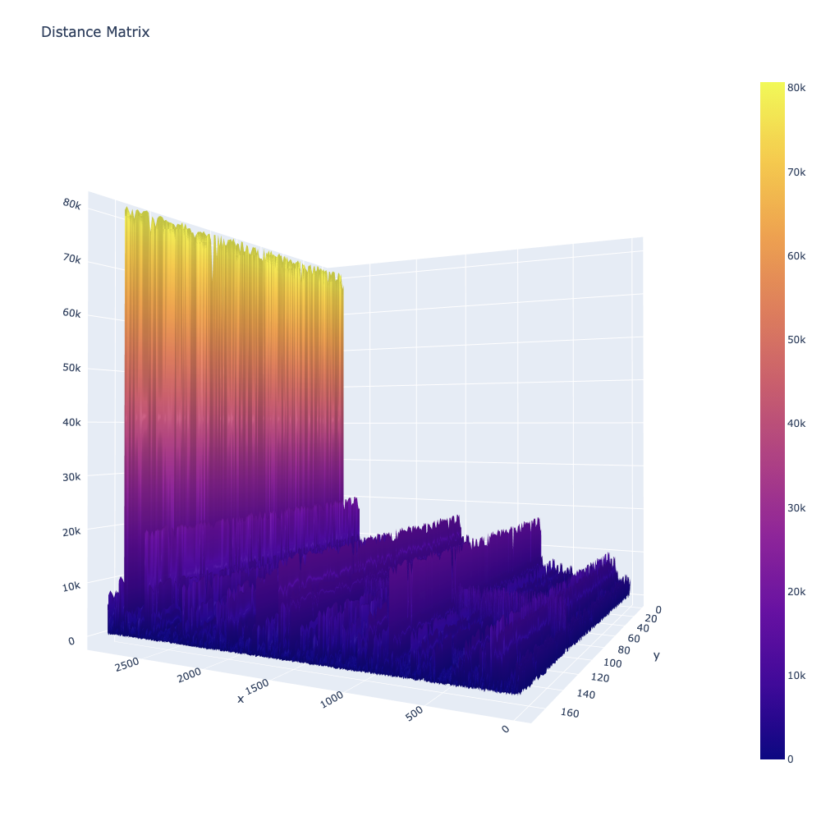
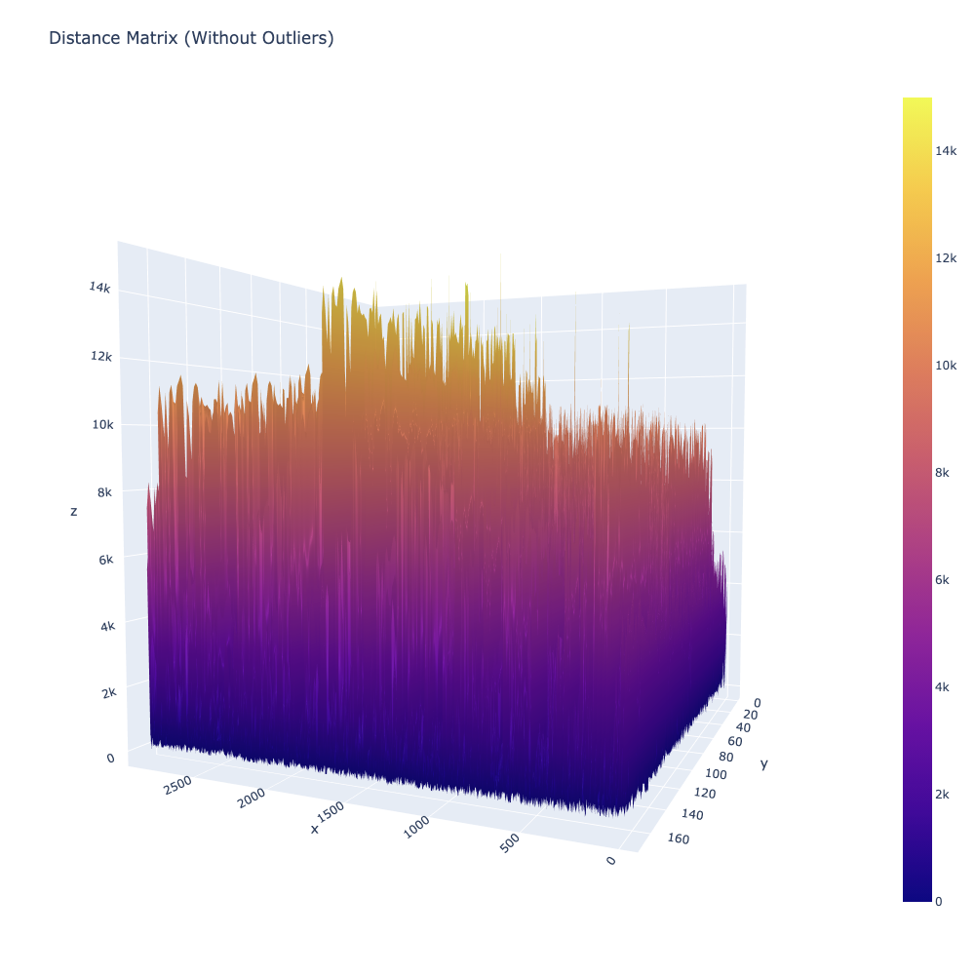
Euclidean : Outlier Detected
Outlier threshold : 14k

Slide 13
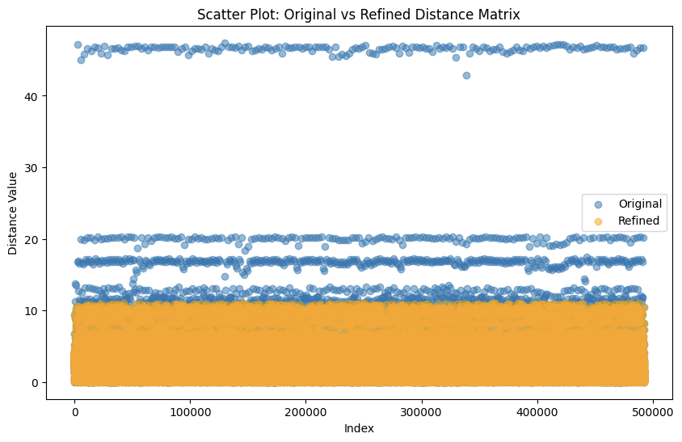
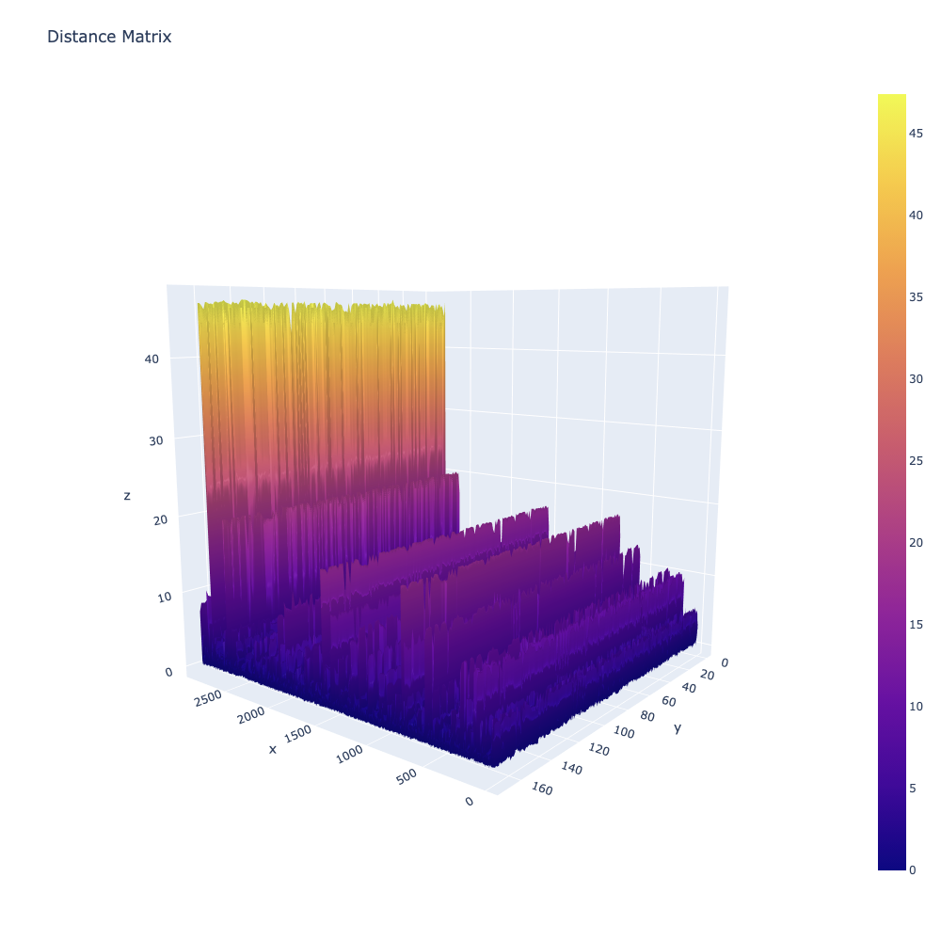
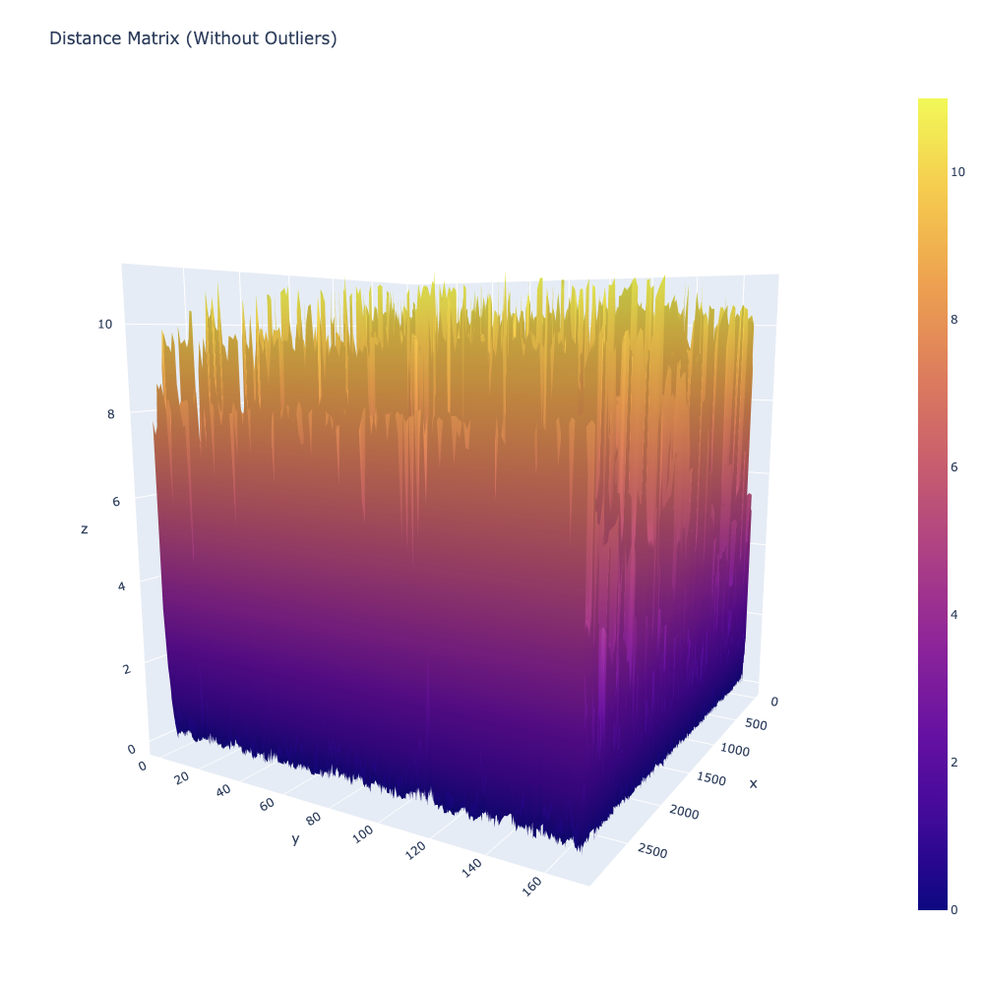
Mahalanobis- > Outlier Detected
Outlier threshold : 11

Slide 14
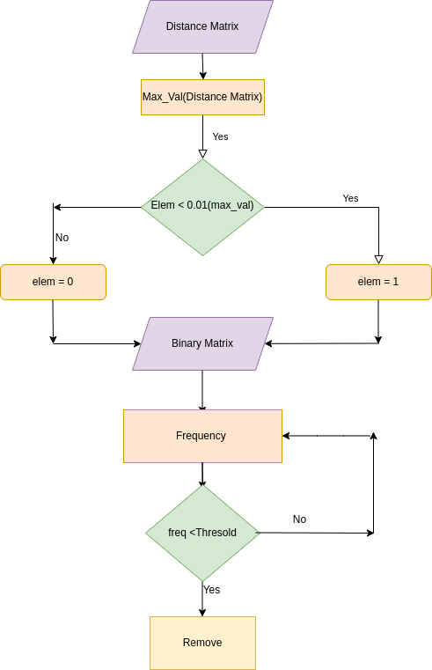
SORTING AND PRIORITIZATION

Slide 15
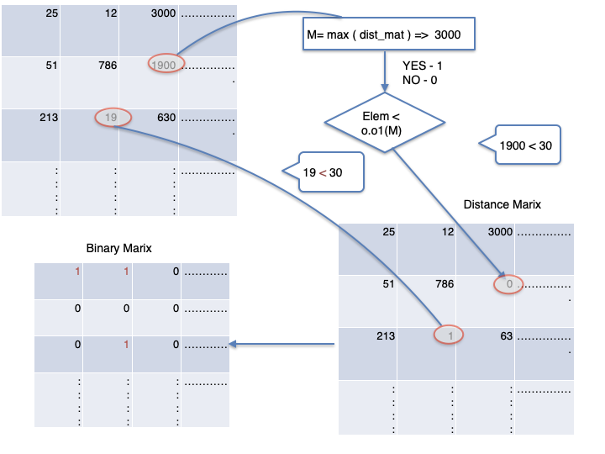

Slide 16
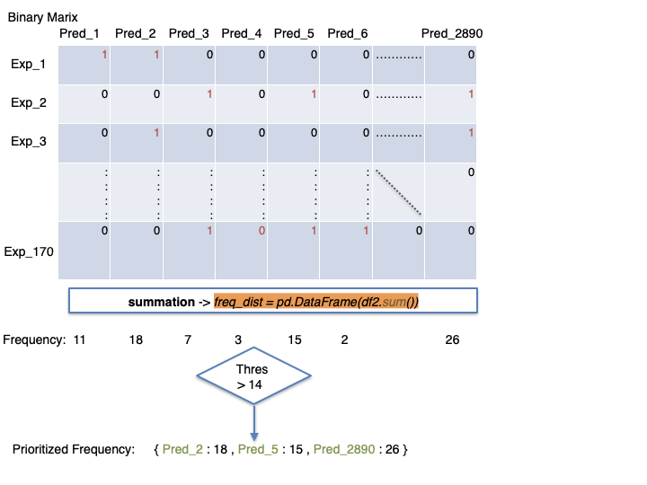

Slide 17
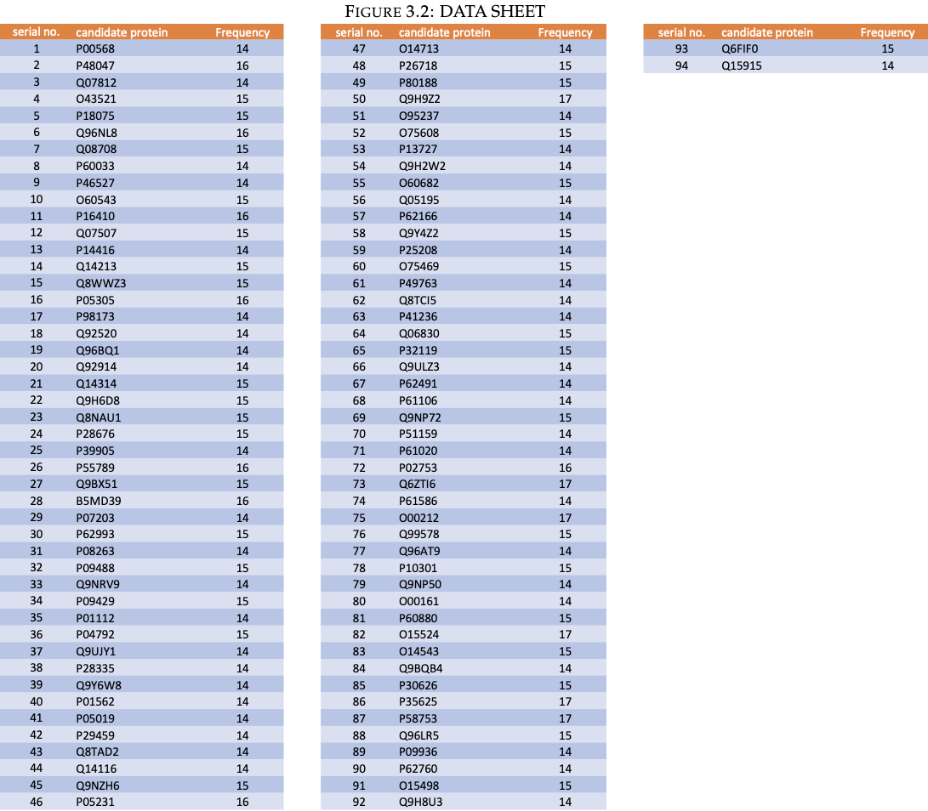
Euclidean Distance : Result

Slide 18
Mahalanobis Distance : Result
Serial no | Candidate Gene | Frequency
1 | Q9Y276 | 13.0
2 | P16070 | 13.0
3 | P19883 | 13.0
4 | Q9HBA9 | 13.0
5 | Q9UJU5 | 13.0
6 | A8MYZ6 | 13.0
7 | O14926 | 13.0
8 | Q9BXM9 | 14.0
9 | Q96AE4 | 14.0

Slide 19
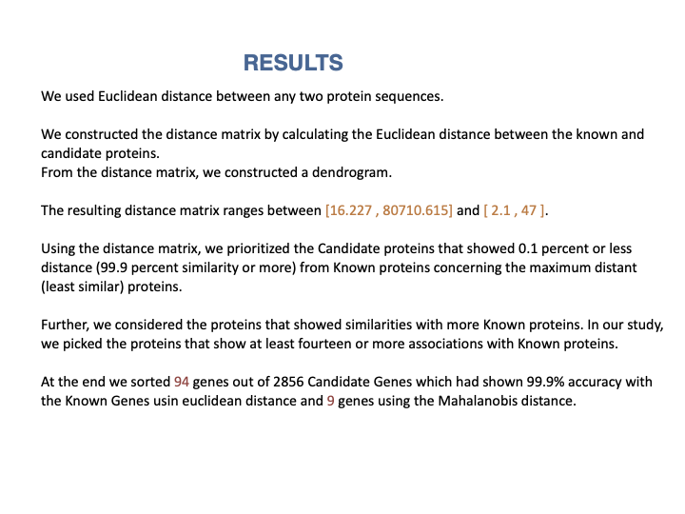

Slide 20
REFERENCES:
1. Identification of Novel Type 2 Diabetes Candidate Genes Involved in the Crosstalk between the Mitochondrial and the Insulin Signaling Systems.((https://doi.org/10.1371/journal.pgen.1003046).
2. Prioritizing the candidate genes related to cervical cancer using the moment of inertia tensor.(https://onlinelibrary.wiley.com/doi/epdf/10.1002/prot.26226)
3. Wąż P, Bielinska-W _x0001_ ąż D. Moments of inertia of spectra and distribution moments as molecular descriptors. MATCH Commun Math Comput Chem. 2013;70:851-865
4. Hou W, Pan Q, He M. A new graphical representation of protein sequences and its applications. Phys A Stat Mech Appl. 2016;444:996- 1002. https://doi.org/10.1016/j.physa.2015.10.067

